Slide 1
Data Mining
October 28th 2020
Manel AGUILAR BARROSO
Daniel CANO CARRASCOSA
Oriol CATASÚS LLENA
Jesus MOLINA ROLDAN
Eduard ORTUÑO GARROTE
Adrià VENTURA HERCE

Slide 2
Outline of talk
Work overview
Data mining process
Descriptive analysis
Univariate descriptive analysis
Bivariate descriptive analysis
Preprocessing
Scree plot
Factorial map visualization
Relationship among variables
Conclusions of PCA
Clustering process
Tools of class interpretation used
Profiling graphs
Final class profiling
PCA and Hierarchical Clustering
Conclusions
Original and final scheduling

Slide 3
Graphics Processing Units (GPUs)
GPU is one of the most important part of a computer
Goal of the project:
Deepen our understanding about GPU
Learning how its different features are related with each other
Data Overview
3406 models of GPUs, from 2000 until 2017
21 variables
About 8.03% of nulls

Slide 4
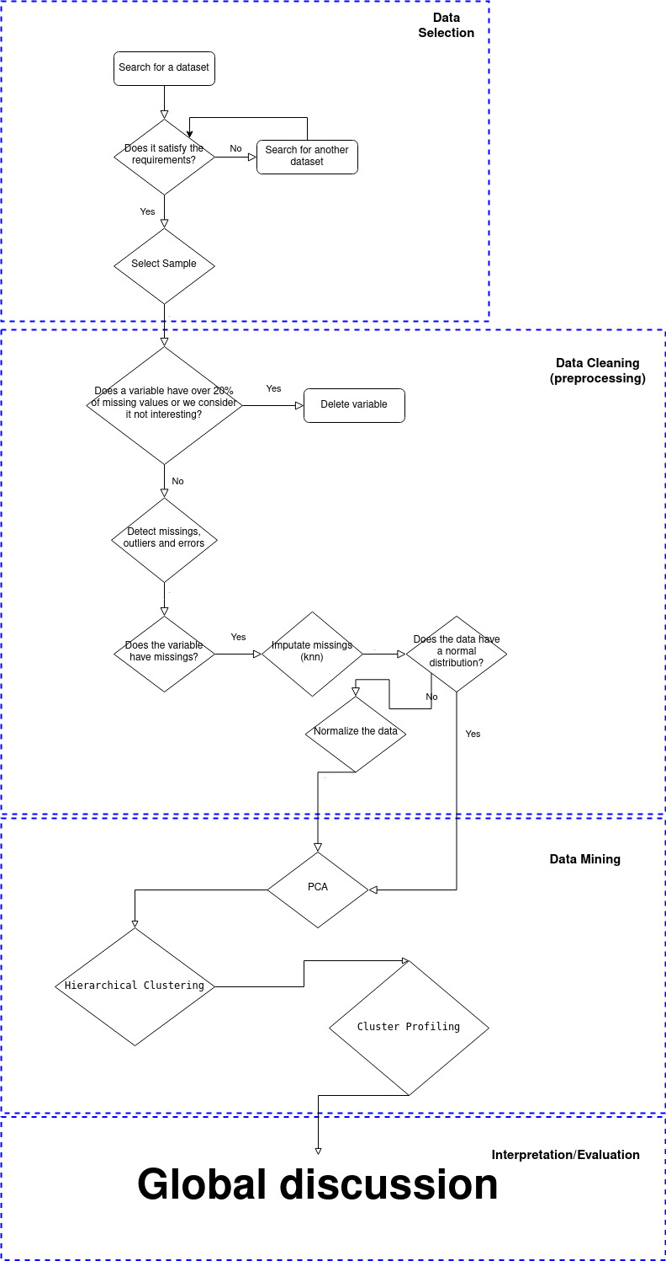
Data Mining process
Data Selection
Data Cleaning
Data Mining
Interpretation/Evaluation

Slide 5
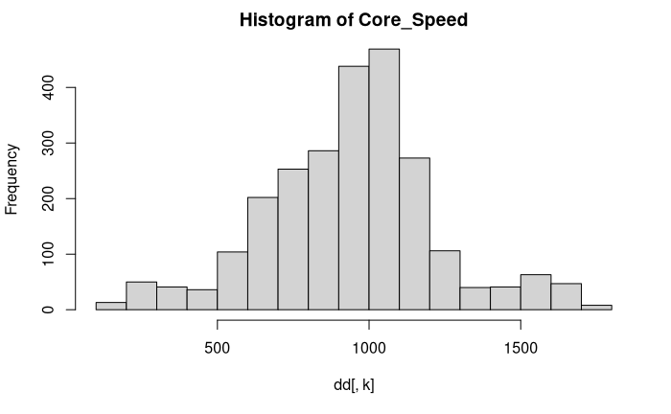
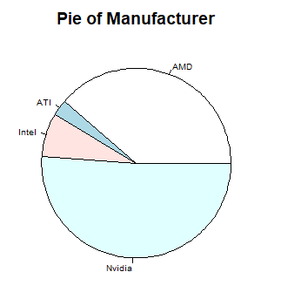
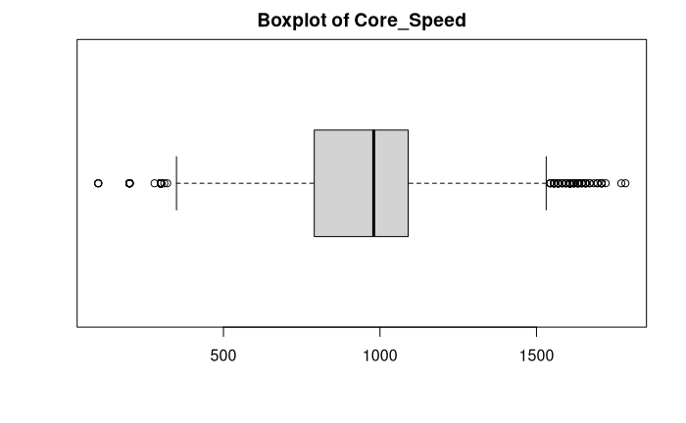
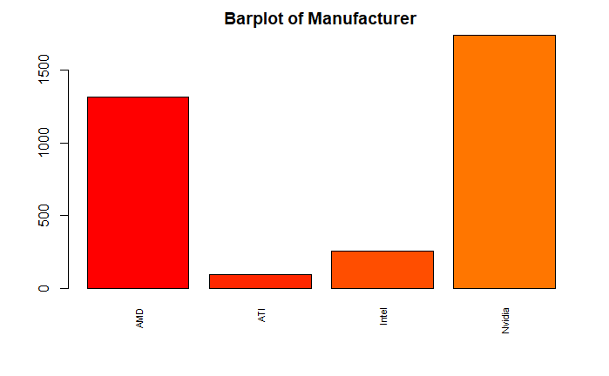
Descriptive analysis

Slide 6
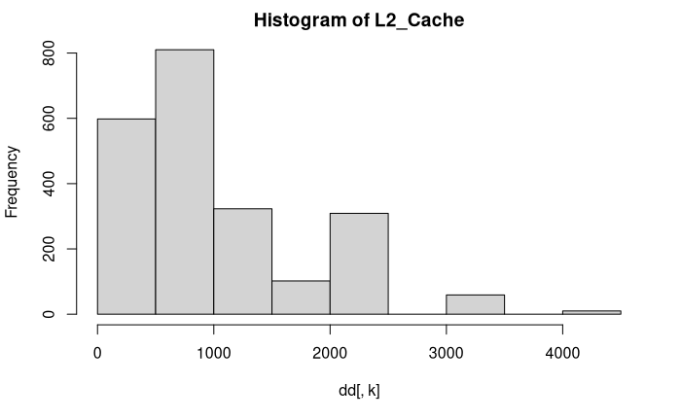
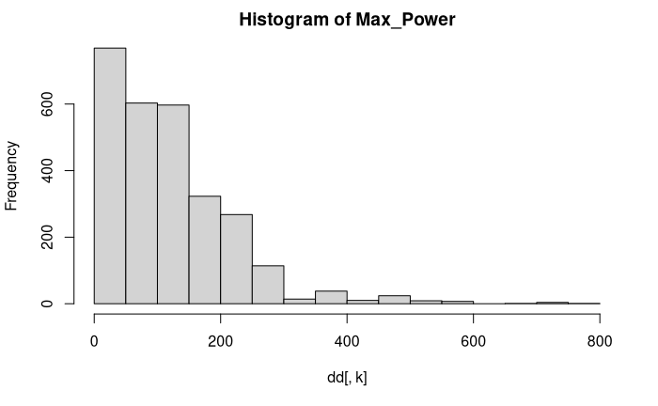
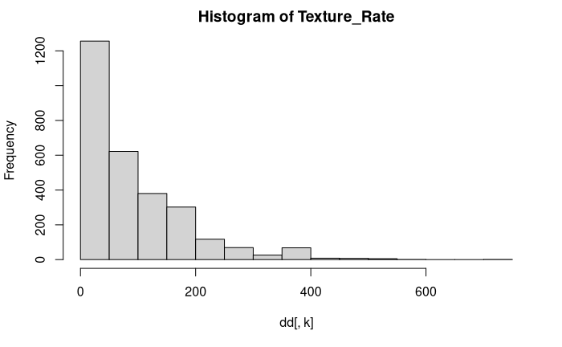
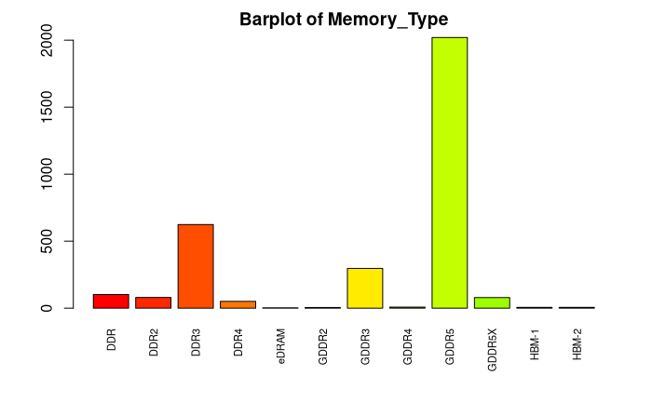

Slide 7
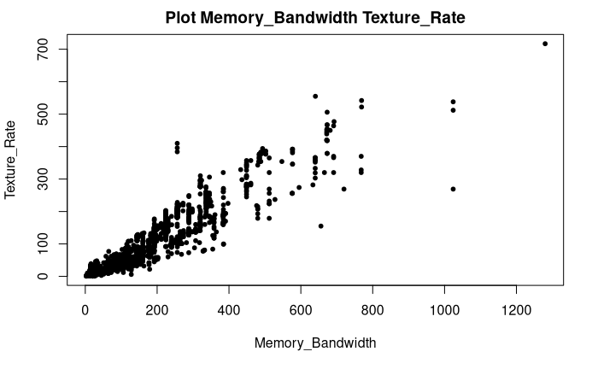
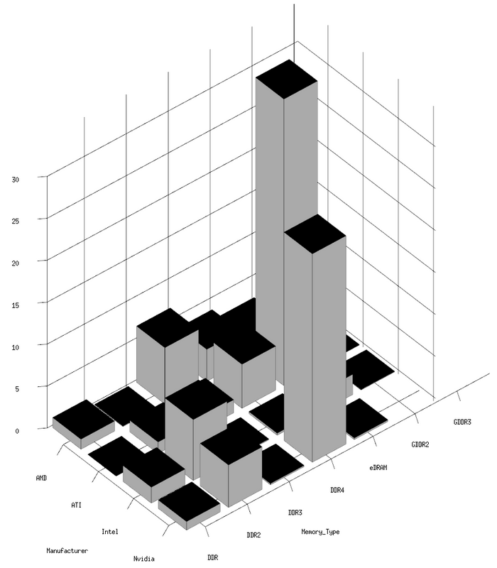
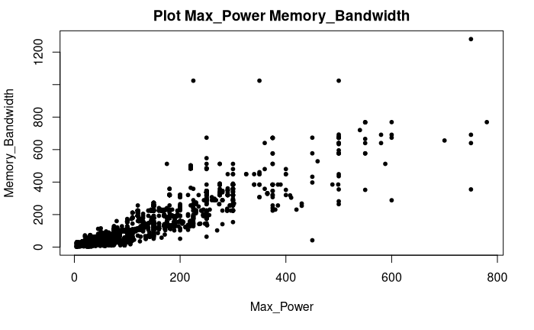
Bivariate descriptive analysis

Slide 8


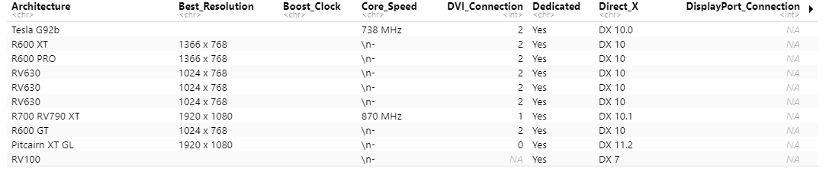
Preprocessing

Slide 9

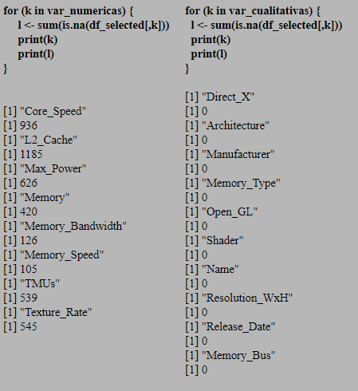
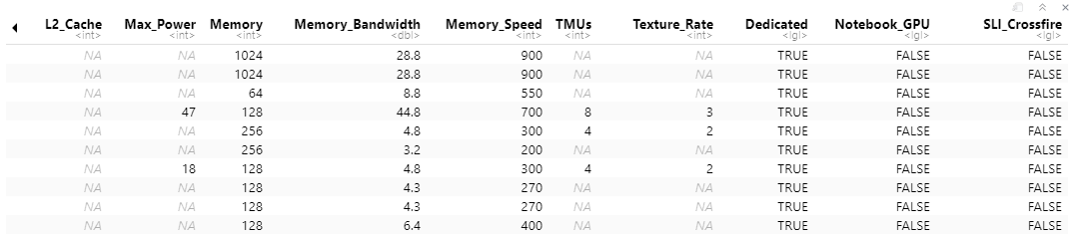
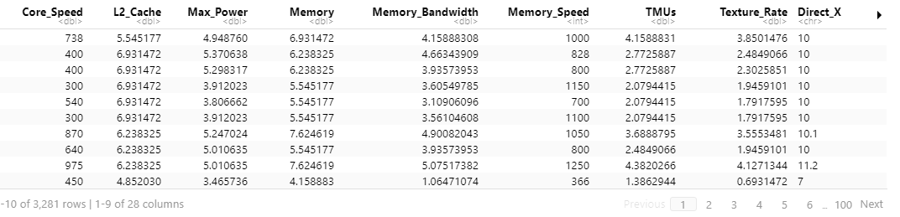

Slide 10
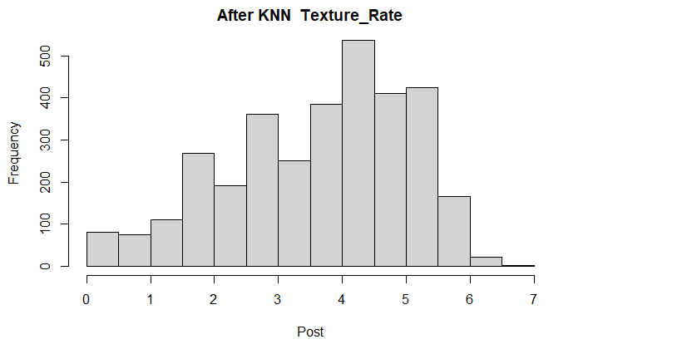
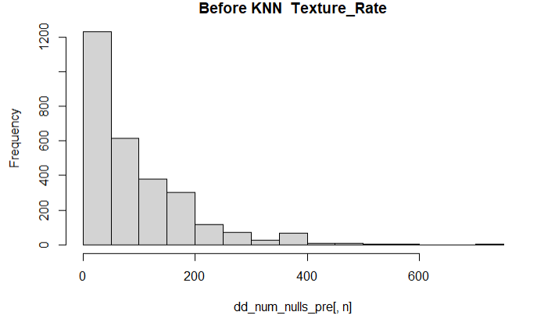

Slide 11
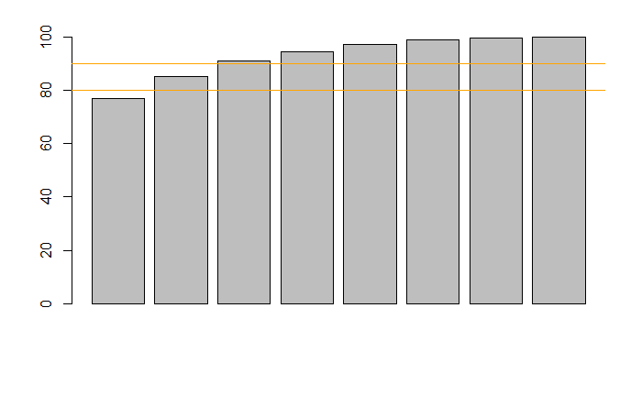
Scree Plot

Slide 12
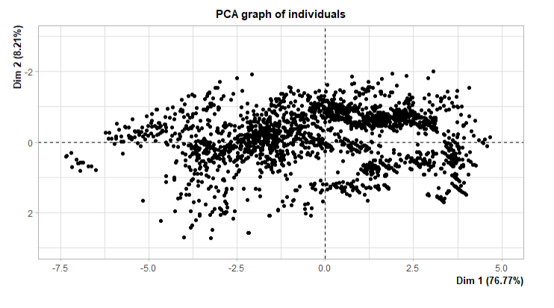
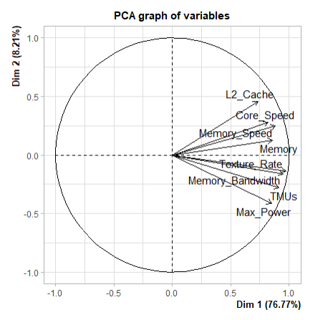
Factorial map visualization

Slide 13
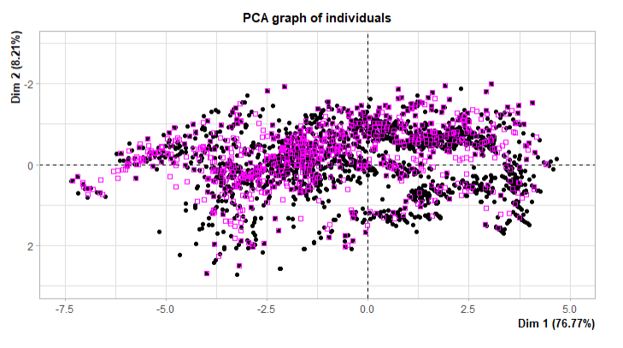

Slide 14
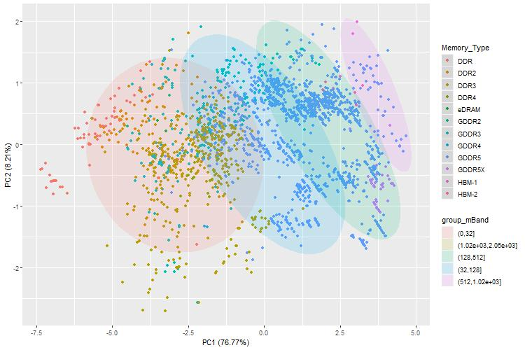
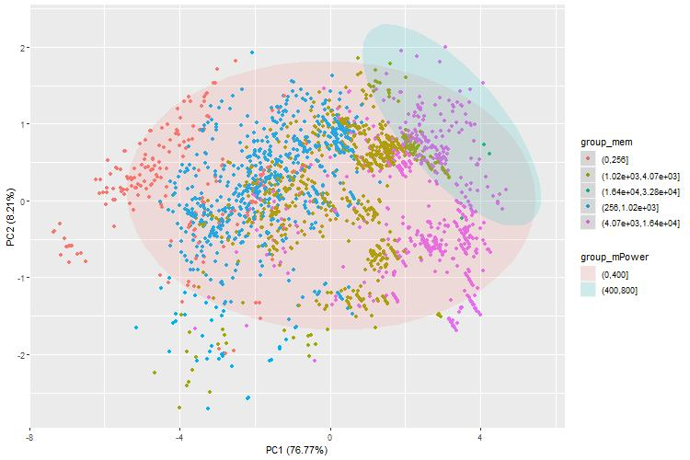
Conclusions of PCA

Slide 15
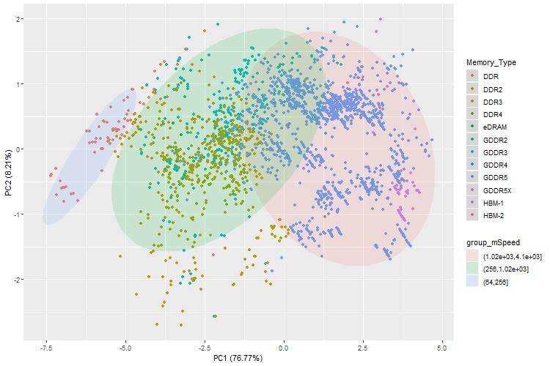
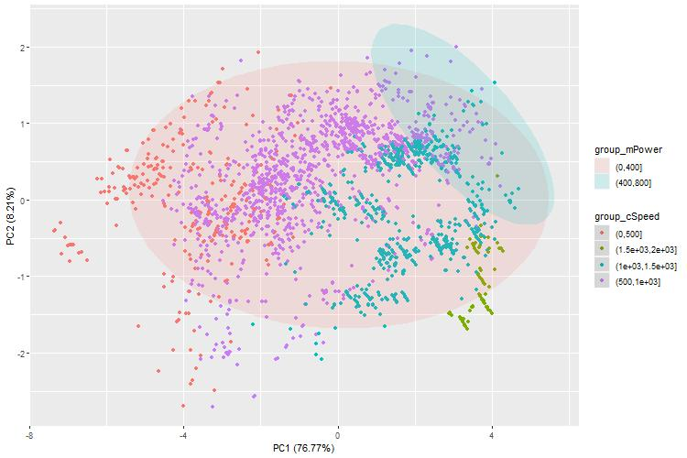

Slide 16
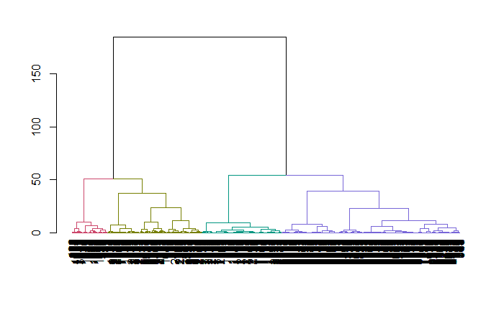
Clustering process
Almost all data used
Gower dissimilarity coefficient
Ward.D aggregation criteria
4 clusters
Class 1: 798
Class 2: 675
Class 3: 1507
Class 4: 301

Slide 17
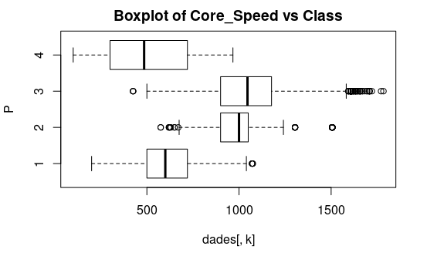
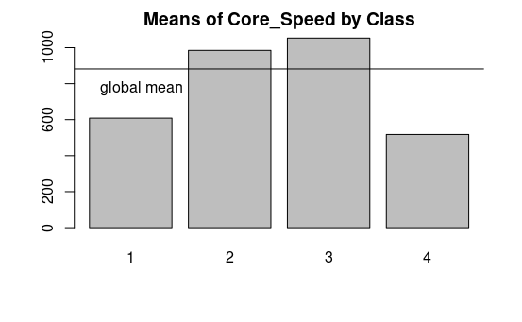
Tools of class interpretation used

Slide 18
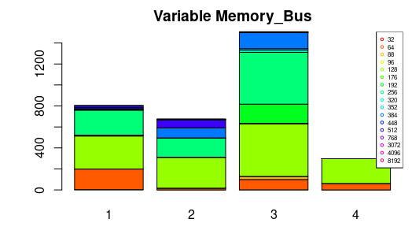
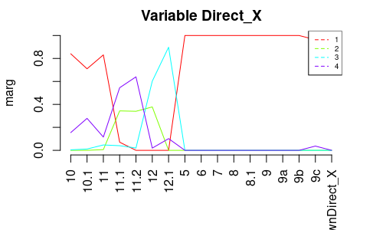
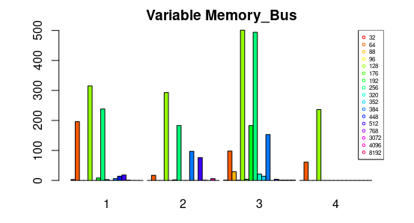

Slide 19
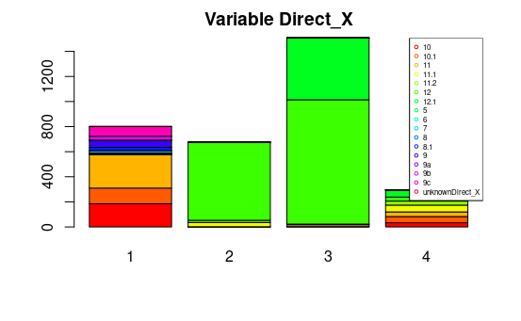
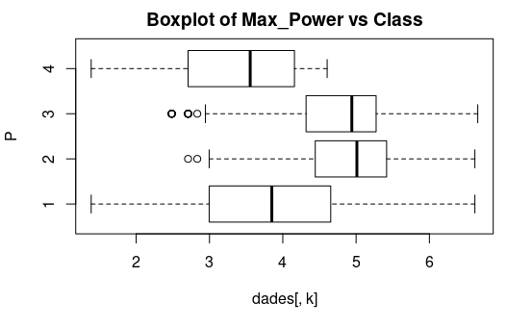
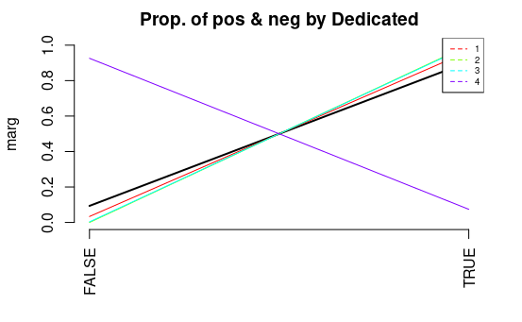
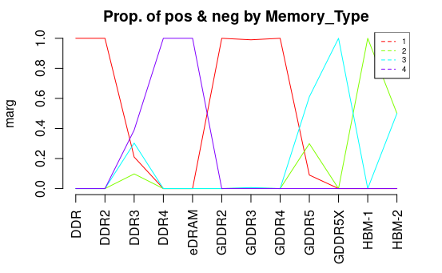
Profiling graphs

Slide 20
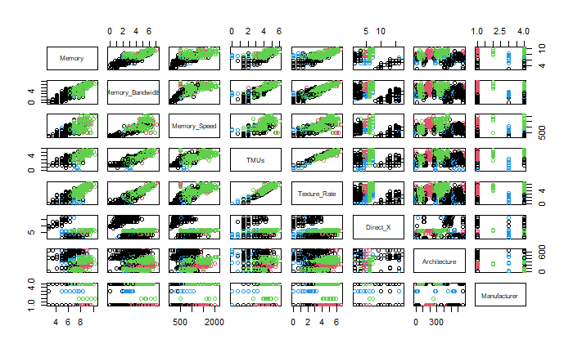
Final class profiling

Slide 21
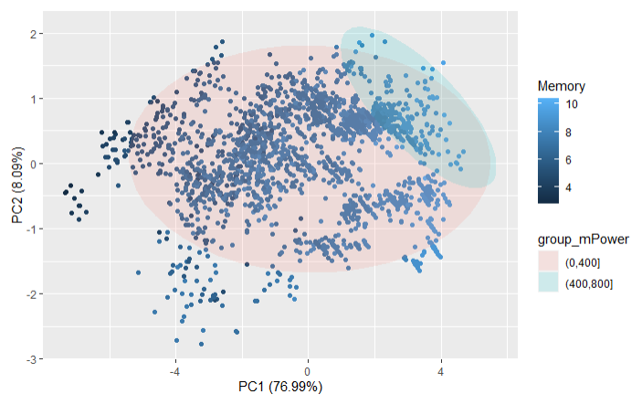
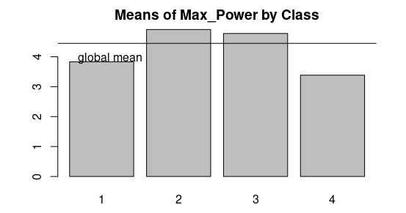
PCA and Hierarchical Clustering

Slide 22
Conclusions
Relationship between Memory Bus and Core Speed
Group of GPUs with
high power consumption
shared features
Identification of clusters of GPUs grouped by performance

Slide 23
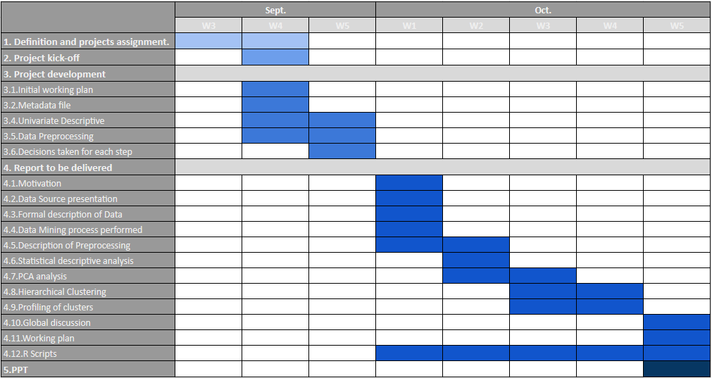
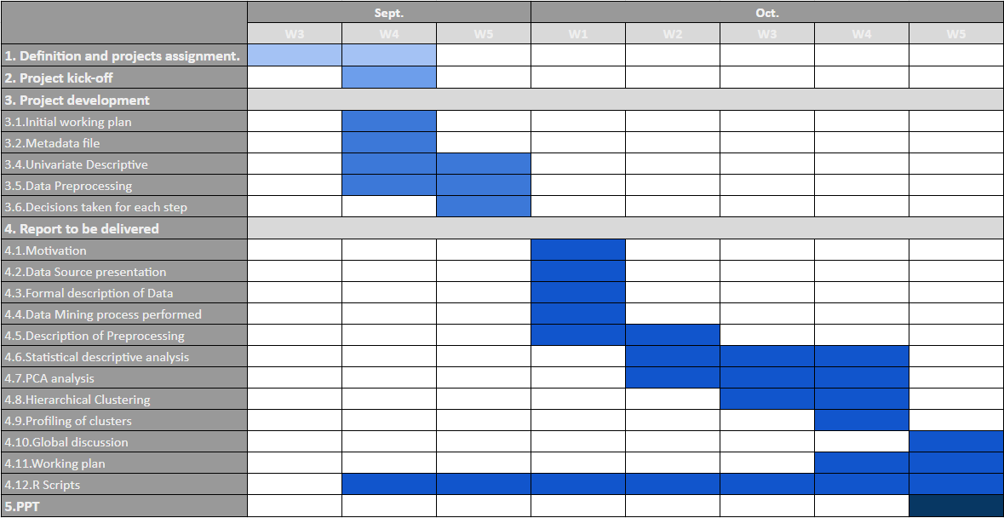
Original and final scheduling

Slide 24
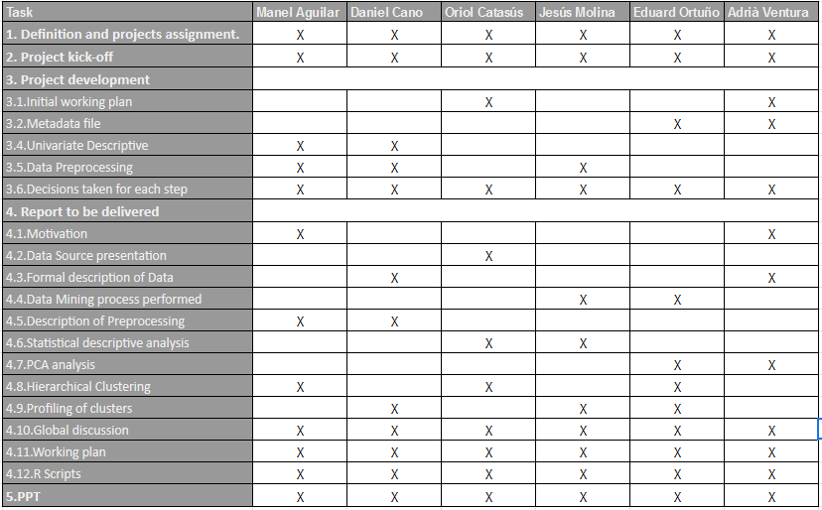
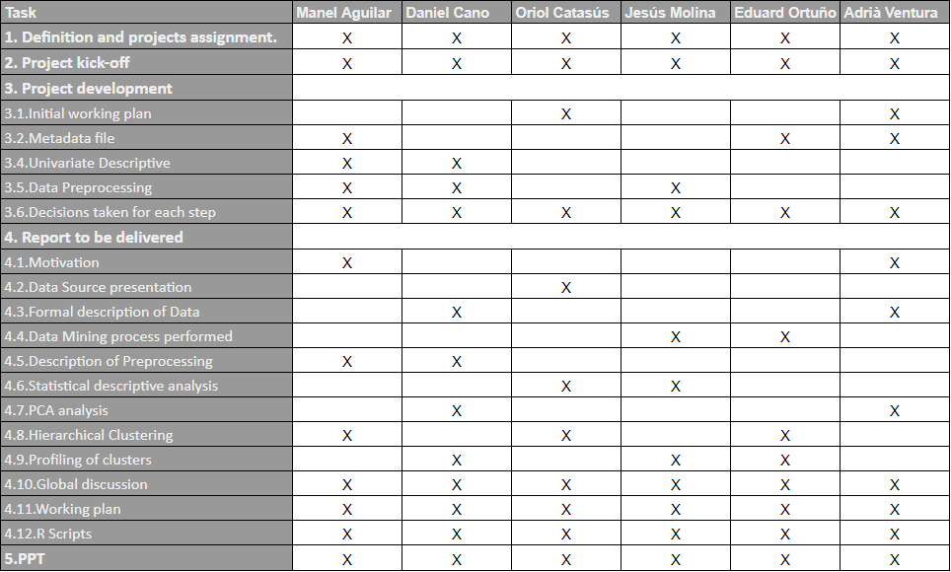
Original and final scheduling

